Slide 1
Introduction to NI Actor Framework
How to integrate DIM?
DIMActor Ancestor Class
DIMActor von Dr. Holger Brand steht unter einer Creative Commons Namensnennung - Nicht-kommerziell - Weitergabe unter gleichen Bedingungen 3.0 Unported Lizenz. Über diese Lizenz hinausgehende Erlaubnisse können Sie unter https://www.gsi.de/work/organisation/bereiche/personalrecht/patente_und_technologietransfer.htm erhalten

Slide 2
Agenda
Prerequisites
Motivation: Active objects
LVOOP
Pros & Cons
Application
NI Actor Framework
DIM
Example:
DIMActor anchestor class
DIMActor derived classes
DIMDemoServer
DIMDemoClient
How to extend existing Actors?
References

Slide 3
Prerequisites
LabVIEW Basics 1 & 2
Project Explorer
Libraries
Dataflow concept
Is knowledge about object oriented programming necessary?
No!
LabVIEW-Classes enables a developer to define his own data types, that provide much more abilities than (strict) type-definitions.
Experience with conventional OO programming languages, e.g. C++ or Java, is maybe confusing.

Slide 4
LabVIEW Dataflow
No variables are existing in LabVIEW
There are data sources and data sinks!
A priori it is not clear from where data is originating! E.g.:
From front panel controls in case of interactive mode.
From calling VI as parameter via connector pane.
Local and global variables are not really variables with respect to common sense, but different places in memory which are copied by LabVIEW Runtime-Engine asynchronously. This can lead to unintentional race conditions.
Copies of data are created at wire forks.
The compiler is responsible to maintain a minimum number of copies to be used.
Therefore LabVIEW is inherent thread-save!
LabVIEW provides several options to transport data safely with respect to data flow without race conditions between different threads, VIs or loops.
Queues, Notifications, FGV optionally protected by Semaphore etc.
That’s all true for LabVIEW Objects, too!

Slide 5
Pros of LVOOP Classes (in comparison to type definitions)
Encapsulation
Attribute data is always private. It can be changed by class methods only.
The internal data structure is hidden.
Access rights: Public, Protected, Private, Community (friend)
Modularity
Each class has its own clearly defined responsibility.
The public interface should be well defined.
It should be modified with very good reason, only!
Eases testability.
Extensibility
Derived classes extend the attributes and methods of their ancestor class.
Specialization
Derived classes special the behavior of their ancestor class.
LabVIEW Objects behave exactly like other LabVIEW data types
They are following the dataflow paradigm!

Slide 6


LVOOP Cons - Solutions
There are no real cons.
(Copy-) Constructors and Destructors are not existing.
They are simply not necessary.
LabVIEW Objects behave the same as other LabVIEW data types.
Attributes are always private.
They cannot be displayed or changed directly on the front panel.
XControls are the solution for this problem.
XControls can also be used as probes.
Polymorphic class-VIs are not supported.
Parameters could be implemented as derived class of a common ancestor class.
Parameters as Variant.
Especially Variant-Attributes.
Multiple inheritance is not supported.
An alternative is the Composition design pattern
References to Objects
Dataflow: Single Element Sized Queue
Data Value Reference
Danger of deadlocks

Slide 7
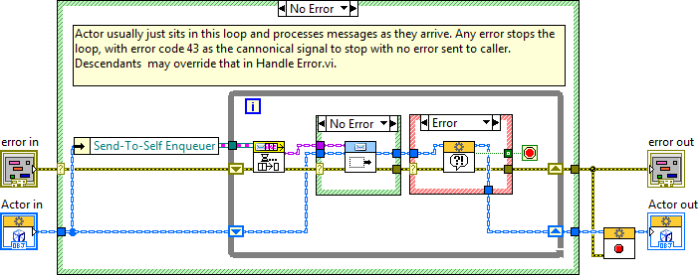
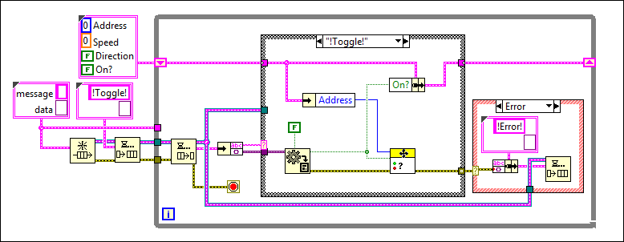
LVOOP Application
Possible cases for the application of LVOOP classes:
Cluster or type definitions, which become potentially extended, can be replaced with classes.
Derives classes add attributes to the ancestor class.
Replacement of data type dependent (e.g. Enumeration) Case-Structures by dynamic dispatching.
Dependent of the objects class the correct corresponding Overwrite-VI is called.
Beispiel: Queued State-Maschine
Development of generic frameworks
The application layer uses base classes only.
Details are implemented in derived classes.
Actor Framework ..............................................

Slide 8
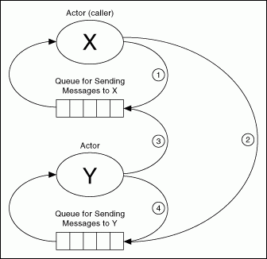
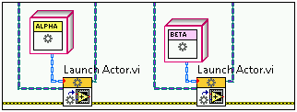
NI Actor Framework Communication Scheme – Local Queues
Launching Actors
Actors are derived classes of Actor.lvclass
Caller-Enqueuer is used by Actor to send messages to the Caller.
Actor-Enqueuer is used by Caller to send messages to the Actor.
Asynchronous Communication via Queue
Messages are derived classes of Message.lvclass
Messages are calling public VIs of an Actor.
Actor-Messages can be generated automatically be using Tools>Actor Framework Message Maker.
Linked Network Actor: https://decibel.ni.com/content/docs/DOC-24051
is using a nested actor maintaining networkstreams.

Slide 9
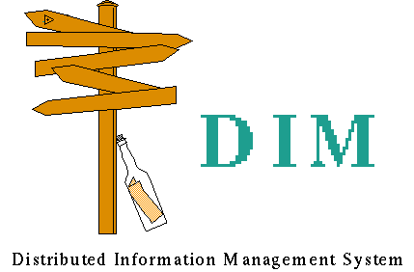
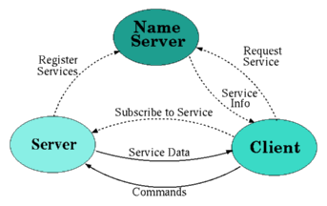
Network Communication: DIM
Originally developed at CERN (www.cern.ch/dim)
DIM provides
Publisher-Subscriber Pattern
Command Pattern
DIM connects heterogenous systems.
Various operating systems
Various programming languages
LabVIEW-DIM-Interface is existing
http://wiki.gsi.de/cgi-bin/view/CSframework/LVDimInterface

Slide 10
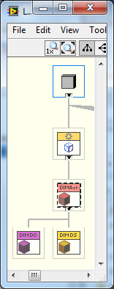
DIMActor – Project & Class Hierarchy
DIMActor.lvlib contains
DIMActor.lvclass derived from Actor.lvclass
DIMActor Messages
DIMActorDemo.lvlib contains
Server
DIMDemoServer.lvclass derived from DIMActor.lvclass
Server Messages
Client
DIMDemoClient.lvclass derived from DIMActor.lvclass
Client Messages
Application: Test.vi

Slide 11
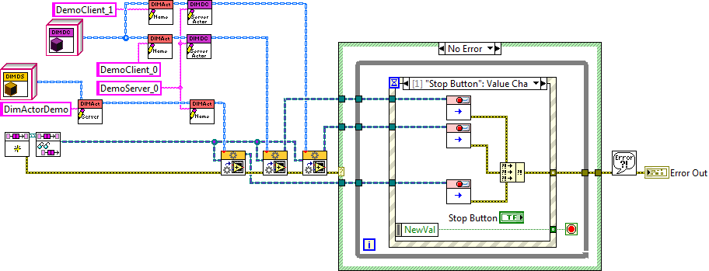
DIMActor Demo Application
Initialize Caller to Actor Queue
Initialize DIMDemoServer
Initialize two DIMDemoClients
Launch Actors
Wait for Stop
Sent Stop-Messages
Report Error

Slide 12
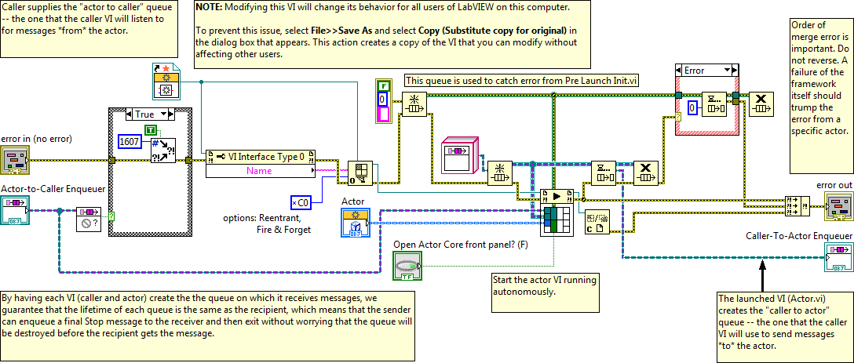
Launch Actor

Slide 13
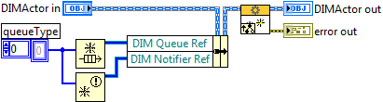
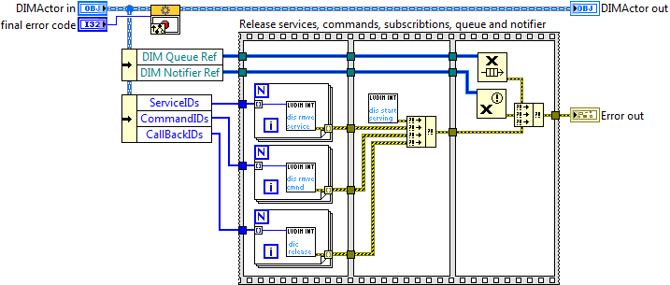
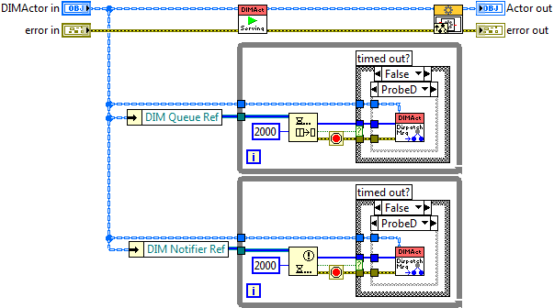
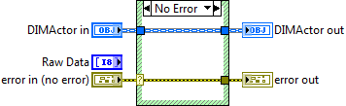
DIMActor – Overwrite VI‘s
Pre Launch Core.vi
Stop Core.vi
Actor Core.vi
Dynamic Dispatch-VI:
CastByteArrayAndDispatchMsg.vi

Slide 14
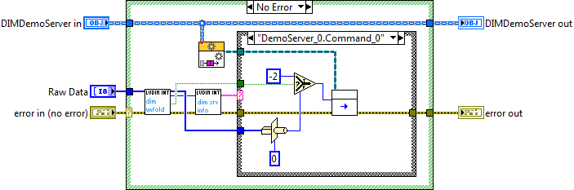
DIMActor – Dynamic Dispatch VI
Dynamic Dispatch-VI:
CastByteArrayAndDispatchMsg.vi
Example DIMDemoServer.lvclass:
CastByteArrayAndDispatchMsg.vi

Slide 15
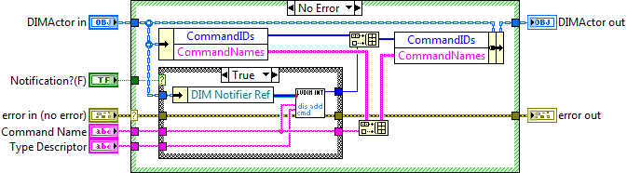
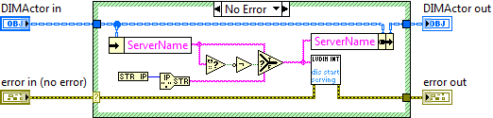
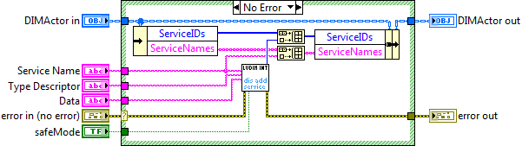
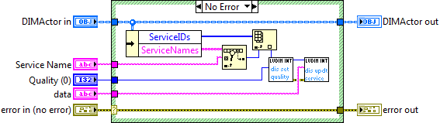
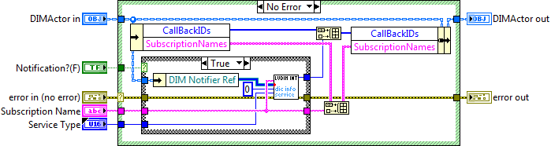
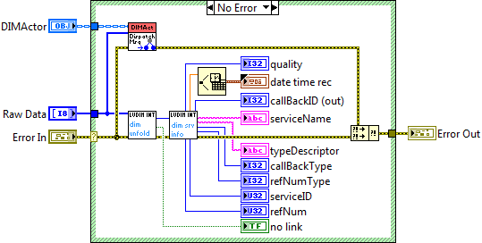
DIMActor – Other VIs
Add Command
Start Serving
Add Service
Update Service
Add Subscription
Probe

Slide 16
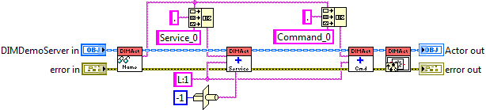
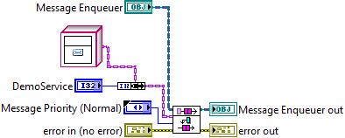
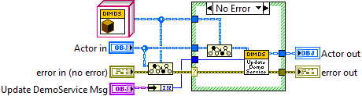
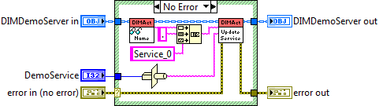
DIMDemoServer.lvclass:Actor Core.vi

Slide 17
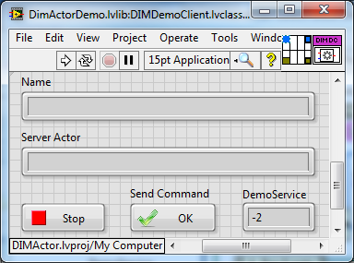
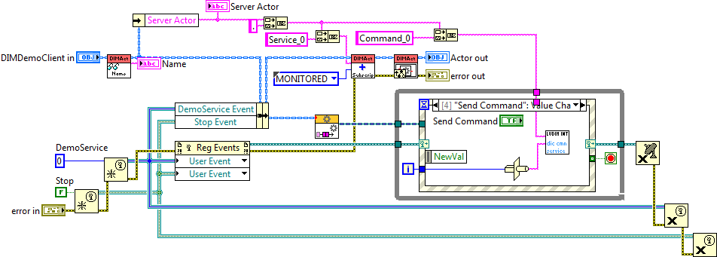
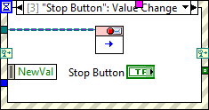
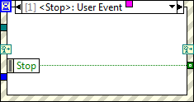
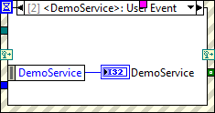
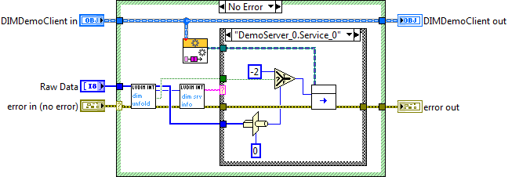
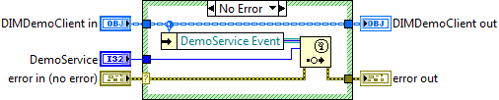
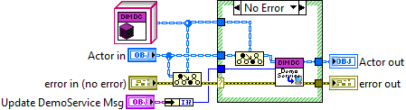
DIMDemoClient.lvclass:Actor Core.vi

Slide 18
Extending existing Actors to use DIM
Inherit from DIMActor.lvclass instead of Actor.lvclass
or create a new derived DIMActor class to be used as nested Actor.
Extend Actor Core.vi to add
Commands
Services
Subscriptions
Overwrite: CastByteArrayAndDispatchMsg.vi
For each Command and Subscription
Typecast DIM byte-array to expected G data type
Send corresponding (already existing) Message to self or owner if nested.
Publish Service data where necessary.
or send Messages to nested DIMActor
Use CoreLib.CallProcess.vi to send Messages to CS-Objects

Slide 19
References
LabVIEW Menu -> Help -> Search the LabVIEW Help... -> Contents -> Fundamentals -> LabVIEW Object-Oriented Programming
LabVIEW Menu -> Help -> Find Examples -> Browse by Task -> Fundamentals -> Object-Oriented
LabVIEW Object-Oriented Programming: The Decisions Behind the Design
LabVIEW Object-Oriented Programming FAQ
Applying Common OO Design Patterns to LabVIEW
Actor Framework
Measurement Abstraction and Model-View-Controller (MVC) Project with Actor Framework in LabVIEW
HGF Baseclass Library
Mobile Agent System
Thanks to Stephen Mercer for his contributions to web documents & discussions

